Slide 1


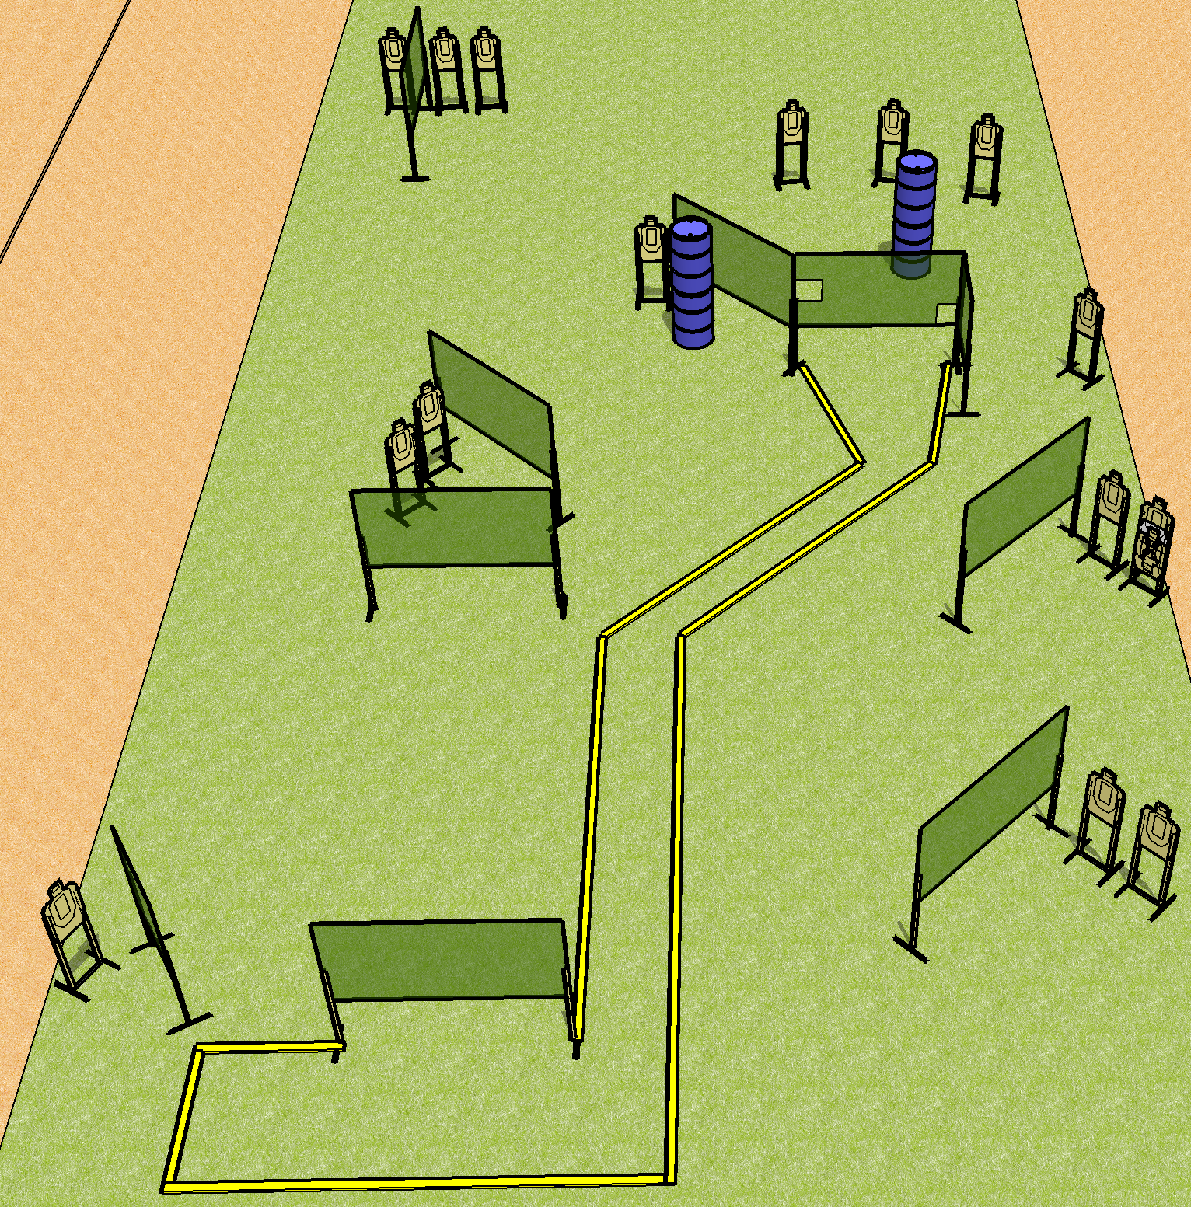
 | Dothan Gun Club – USPSA Match Road to Somewhere Course Designer : Drew Coleman
Round Count 32 rounds 16 USPSA
Equipment List 19 wall feet 2 medium fault lines 17 targets (16 + 1 NS)

Slide 2
Road to Somewhere
Written Stage Briefing
Road to Somewhere is a 32 round, 160-point, Comstock course of fire. There are 16 USPSA targets. The best 2 hits will score.
Handgun start position is both hands touching mark. Handgun is loaded and holstered.
PCC start position is stock on belt, muzzle touching mark. Loaded carbine is held with both hands, safety on.
On the audible start signal, engage targets as they become available from within the shooting area.

